Slide 1
DNA Fountain Seminar Datenmanagement
Nako Nachev

Slide 2
DNA Fountain coding strategy
Encoding overview
Preprocessing
Luby Transform
Random selection
Soliton distribution
Seed selection (LSFR)
Droplet creation
Screening
Oligos generation
Decoding process

Slide 3
Preprocessing stage (Segmentation)
Preprocessing
Luby Transform
Random selection
Soliton distribution
Seed selection (LSFR)
Droplet creation
Screening
Oligos generation
Files are initially packaged (tar) and compressed using gzip
Compressed file is partitioned in non-overlapping segments of length L
In case of segments having len(segment) < L we fill the missing bits with zeroes
1 | 0 | 1 | 0 | 0 | 0 | 0 | 0| 1 | 1 | 1 | 1 |
1 | 0 | 1 | 0
0 | 0 | 0 | 0
1 | 1 | 1 | 1

Slide 4
Luby Transform (Random selection)
Preprocessing
Luby Transform
Random selection
Soliton distribution
Seed selection (LSFR)
Droplet creation
Screening
Oligos generation
Luby Transform stage is responsible for the droplet/oligo generation
It begins by randomly choosing how many segments to combine
This is achieved via the robust soliton distribution
The “combination” of segments is achieved by XOR-ing (Bitwise addition mod 2) the individual segments

Slide 5
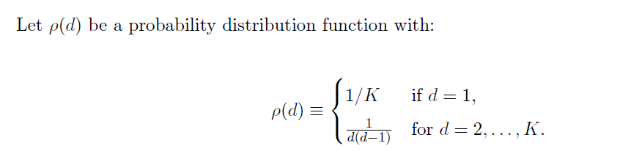
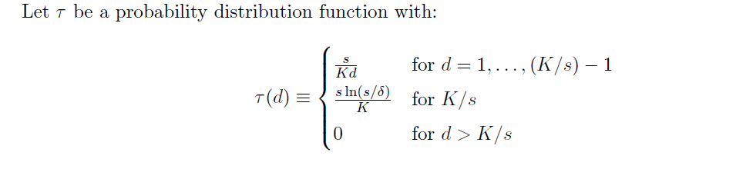
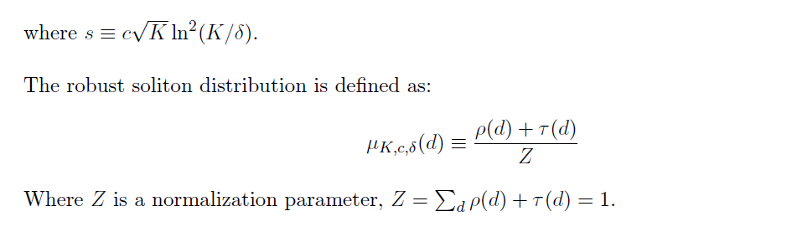
Luby Transform (Robust Soliton Distribution)
Preprocessing
Luby Transform
Random selection
Soliton distribution
Seed selection (LSFR)
Droplet creation
Screening
Oligos generation
Ideal soliton dist.
Robust soliton dist.

Slide 6
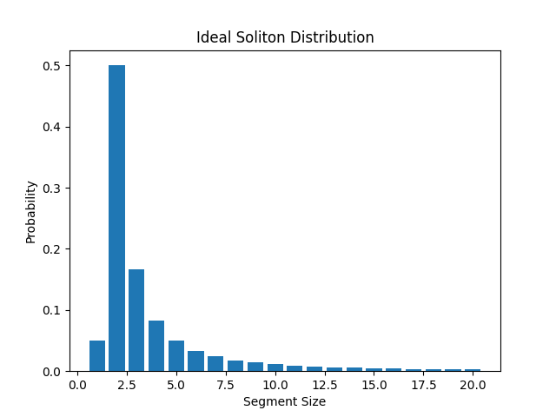
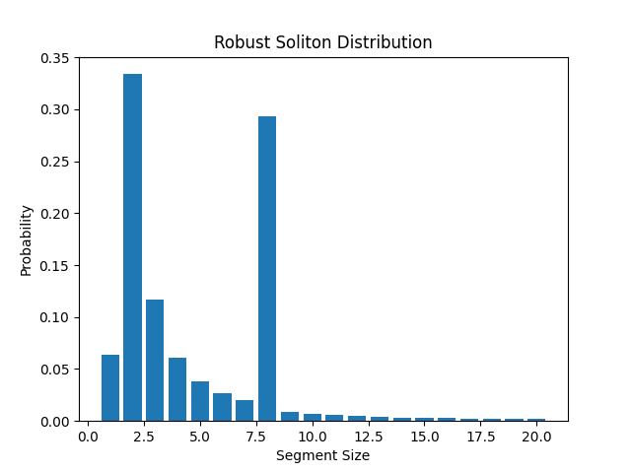
Luby Transform (Robust Soliton Distribution)
Preprocessing
Luby Transform
Random selection
Soliton distribution
Seed selection (LSFR)
Droplet creation
Screening
Oligos generation
Values used: K = 20, c = 0.5, delta = 0.001

Slide 7
Luby Transform (Robust Soliton Distribution)
Preprocessing
Luby Transform
Random selection
Soliton distribution
Seed selection (LSFR)
Droplet creation
Screening
Oligos generation
Upon generation of the distributions – a random choice n is taken
Example:
N = 3
We pick 3 segments at random without replacement
Segments : [1,0,0,1], [0,0,0,0], [1,1,0,0]
Apply bitwise addition: 1001 Ꚛ 0000 Ꚛ 1100 = 0101
The result 0101 is passed to the next stage

Slide 8
Luby Transform (LFSR)
Preprocessing
Luby Transform
Random selection
Soliton distribution
Seed selection (LFSR)
Droplet creation
Screening
Oligos generation
The XOR-ed segments alone are not enough for the droplet generation
A seed needs to be generated using the Linear Feedback Shift Register (LFSR)
A LFSR works the following way:
Take an n-bit binary integer (initial state)
Define a primitive polynomial for the LFSR
Start endlessly transforming it:
Step 1: Shift the numbers to the right
Step 2: Use the predetermined polynomial to calculate the leftmost bit
Step 3: The polynomial determines the so-called “taps”, which are the coefficients of the polynomial
Step 4: XOR the bits under the tap positions to get the leftmost bit
Step 5: Repeat the process
Given the right polynomial a LFSR will cycle out all possible n-bit combinations till we reach the initial state

Slide 9
Luby Transform (LFSR example)
Preprocessing
Luby Transform
Random selection
Soliton distribution
Seed selection (LFSR)
Droplet creation
Screening
Oligos generation
Initial state for 3-bit integer: 100
Polynomial = x^2 + x + 1
This result in having taps (2,1), therefore we XOR the bits on positions 2 and 1 on each cycle
cycle | b1 | b2 | b3
- | 1 | 0 | 0
1 | 0 | 1 | 0
2 | 1 | 0 | 1
3 | 1 | 1 | 0
4 | 1 | 1 | 1
5 | 0 | 1 | 1
6 | 0 | 0 | 1
7 | 1 | 0 | 0
Each state corresponds to a new seed
The seed is then attached to the front of the bitwise addition of the segments
b1 = 0 Ꚛ 0 = 0
b1 = 1 Ꚛ 0 = 1
b1 = 0 Ꚛ 1 = 1

Slide 10
Luby Transform (Droplet creation)
Preprocessing
Luby Transform
Random selection
Soliton distribution
Seed selection (LFSR)
Droplet creation
Screening
Oligos generation
After the seed is attached to the bitwise addition result, we have the droplet formation
Example: seed 10, bitwise addition result 1010 -> droplet is 101010
Since the droplet has to synthesized, we need to convert it to DNA first
Mapping:
00: A
01: C
10: G
11: T
Therefore producing GGG
On demand a RS Code can be attached to the end for error correction
GGGACCG
10101000010110
Seed
Payload
RS-Code

Slide 11
Screening stage
Preprocessing
Luby Transform
Random selection
Soliton distribution
Seed selection (LFSR)
Droplet creation
Screening
Oligos generation
Not part of the original fountain code design
Allows us to complete realize the coding potential of each nucleotide
The created droplet is against 2 conditions:
Condition 1: Long homopolymer runs (e.g. AAAAAA…)
Condition 2: High “GC” content
Both of the above mentioned conditions are undesirable
Difficult to synthesize
Prone to sequencing errors
If any of the both conditions is met – droplet is dropped and process starts from the beginning

Slide 12
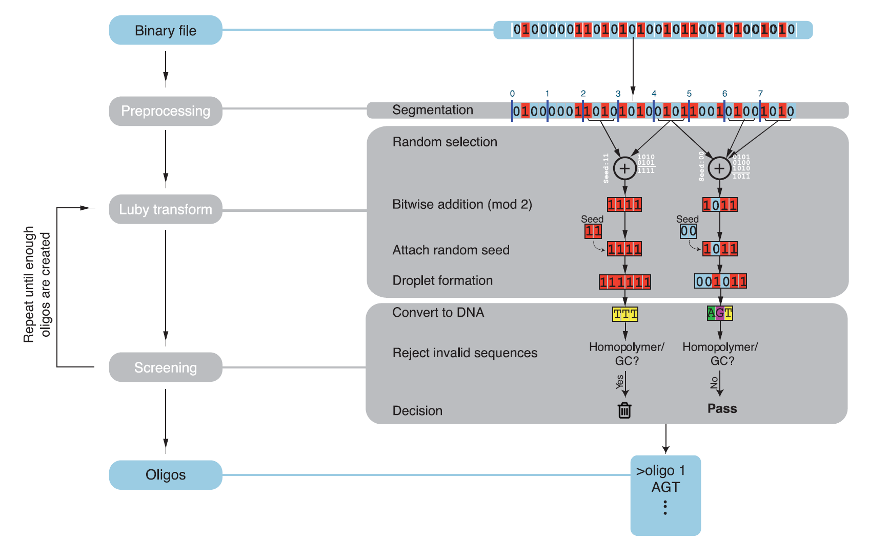
Oligo creation
Preprocessing
Luby Transform
Random selection
Soliton distribution
Seed selection (LFSR)
Droplet creation
Screening
Oligos generation
After the screening stage is complete we receive the final oligo
The process of Luby Transform and Screening is repeated until sufficient number of valid oligos is generated (usually 5 to 10% more oligos than input segments)

